Slide 1
A Liberal Education
J. Bradford Delong
http://bradford-delong.com
brad.delong@gmail.com
@delong
2016-11-04 last updated
key: <https://www.icloud.com/keynote/0nINl20q2hWRDnARhzSkxfbWw>
html: <http://www.bradford-delong.com/2018/06/lecture-a-liberal-education.html>
Notes:
To orient ourselves, let us take the biggest-picture look at the economic history of the human race possible. The anthropologists tell us that we evolved in the Horn of Africa, becoming "anatomically modern" perhaps 200,000 years ago and "behaviorally modern"--which perhaps means acquiring _language_--less than 100,000 years ago.

Slide 2
A Word or Two on a Liberal Education
This is an investment by you in you:
A “liberal education”
Surprise benefits
The value to you of a liberal education
This is an investment by the state of California:
The value to us of your getting a liberal education
This is an investment by the human race:
The value to us of your getting a liberal education
This carries not just privileges and immunities, but responsibilities and obligations
Notes:
They will spend more time on the long 20th century then on any other earlier century. It will be salient, in that more and more that is important happened in the age than in any equal earlier length of time. Between the appearance of the iron-hulled oceangoing steamship, the submarine telegraph cable, and the industrial research lab around 1870 and the business cycle collapse followed by the anemic recovery of 2007-2015, the world was transformed more and more thoroughly than in any easier epoch of its or even many times its length. The two millennia of the discovery of agriculture and herding and the unknown period that marked the discovery and diffusion of fire might have matched it, and the invention of language surpassed it. But otherwise, of all eras that the human race has experienced to date, the long 20th century was the axis on which the wheel of history turned.
This is not to say that people 2000, 3000, 4000 years from now will spend a lot of time thinking about what they will call "ancient history", and we now simply call "history": A lot of water will flow under many bridges in what will be our future and their past. But what of their attention they do focus on us and our predecessors will give a large place to us and to our four generations of immediate ancestors.
The first thing that they will stress is that the history of the long 20th century is predominantly economic, or rather political-economic history.

Slide 3
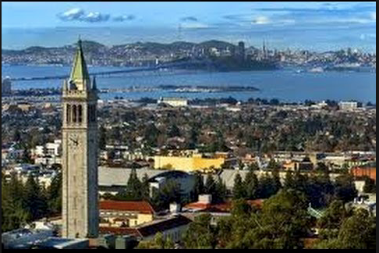
This Is Berkeley!

Slide 4
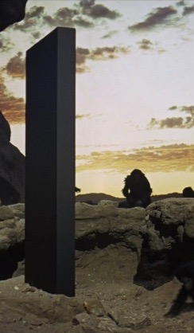
You Are Lucky to Be Here
This is the University of California at Berkeley
Certainly the finest public university in the world
Perhaps the finest university in the world
Lots of opportunities here
Others could be in your seats
They would take advantage of the opportunities here
DON’T WASTE YOUR OPPORTUNITY HERE!!
Notes:
They will spend more time on the long 20th century then on any other earlier century. It will be salient, in that more and more that is important happened in the age than in any equal earlier length of time. Between the appearance of the iron-hulled oceangoing steamship, the submarine telegraph cable, and the industrial research lab around 1870 and the business cycle collapse followed by the anemic recovery of 2007-2015, the world was transformed more and more thoroughly than in any easier epoch of its or even many times its length. The two millennia of the discovery of agriculture and herding and the unknown period that marked the discovery and diffusion of fire might have matched it, and the invention of language surpassed it. But otherwise, of all eras that the human race has experienced to date, the long 20th century was the axis on which the wheel of history turned.
This is not to say that people 2000, 3000, 4000 years from now will spend a lot of time thinking about what they will call "ancient history", and we now simply call "history": A lot of water will flow under many bridges in what will be our future and their past. But what of their attention they do focus on us and our predecessors will give a large place to us and to our four generations of immediate ancestors.
The first thing that they will stress is that the history of the long 20th century is predominantly economic, or rather political-economic history.

Slide 5
You Belong Here
We go fast here
We want to teach you a lot of stuff
You can—and should—handle it
We are confident you belong here—can take advantage of the opportunities
We are rarely wrong
Notes:
They will spend more time on the long 20th century then on any other earlier century. It will be salient, in that more and more that is important happened in the age than in any equal earlier length of time. Between the appearance of the iron-hulled oceangoing steamship, the submarine telegraph cable, and the industrial research lab around 1870 and the business cycle collapse followed by the anemic recovery of 2007-2015, the world was transformed more and more thoroughly than in any easier epoch of its or even many times its length. The two millennia of the discovery of agriculture and herding and the unknown period that marked the discovery and diffusion of fire might have matched it, and the invention of language surpassed it. But otherwise, of all eras that the human race has experienced to date, the long 20th century was the axis on which the wheel of history turned.
This is not to say that people 2000, 3000, 4000 years from now will spend a lot of time thinking about what they will call "ancient history", and we now simply call "history": A lot of water will flow under many bridges in what will be our future and their past. But what of their attention they do focus on us and our predecessors will give a large place to us and to our four generations of immediate ancestors.
The first thing that they will stress is that the history of the long 20th century is predominantly economic, or rather political-economic history.

Slide 6
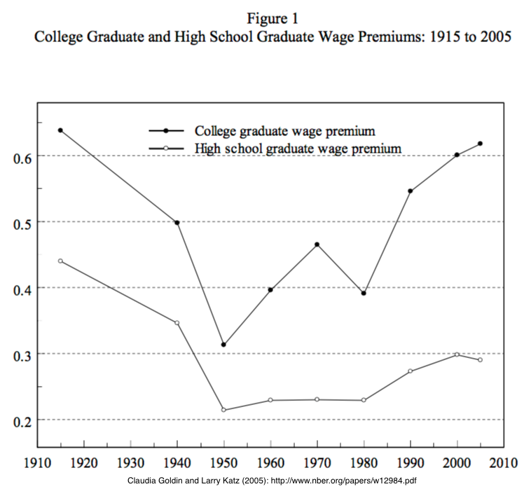
What Is a “Liberal Education”?
“Liberal education” ≠ “kinda left-wing education” here
“Liberal education” here means “appropriate to somebody free”
Someone with control over their own destiny
Someone with a share of control over our common destinies
Notes:
They will spend more time on the long 20th century then on any other earlier century. It will be salient, in that more and more that is important happened in the age than in any equal earlier length of time. Between the appearance of the iron-hulled oceangoing steamship, the submarine telegraph cable, and the industrial research lab around 1870 and the business cycle collapse followed by the anemic recovery of 2007-2015, the world was transformed more and more thoroughly than in any easier epoch of its or even many times its length. The two millennia of the discovery of agriculture and herding and the unknown period that marked the discovery and diffusion of fire might have matched it, and the invention of language surpassed it. But otherwise, of all eras that the human race has experienced to date, the long 20th century was the axis on which the wheel of history turned.
This is not to say that people 2000, 3000, 4000 years from now will spend a lot of time thinking about what they will call "ancient history", and we now simply call "history": A lot of water will flow under many bridges in what will be our future and their past. But what of their attention they do focus on us and our predecessors will give a large place to us and to our four generations of immediate ancestors.
The first thing that they will stress is that the history of the long 20th century is predominantly economic, or rather political-economic history.

Slide 7
What Is a “Liberal Education”? II
Someone with control over their own and a share of control over our common destinies
Not someone taught a particular skill to do one thing
But, rather, someone whose life will be spent in a wide range of activities
And who thus needs a wide range of knowledge
Notes:
They will spend more time on the long 20th century then on any other earlier century. It will be salient, in that more and more that is important happened in the age than in any equal earlier length of time. Between the appearance of the iron-hulled oceangoing steamship, the submarine telegraph cable, and the industrial research lab around 1870 and the business cycle collapse followed by the anemic recovery of 2007-2015, the world was transformed more and more thoroughly than in any easier epoch of its or even many times its length. The two millennia of the discovery of agriculture and herding and the unknown period that marked the discovery and diffusion of fire might have matched it, and the invention of language surpassed it. But otherwise, of all eras that the human race has experienced to date, the long 20th century was the axis on which the wheel of history turned.
This is not to say that people 2000, 3000, 4000 years from now will spend a lot of time thinking about what they will call "ancient history", and we now simply call "history": A lot of water will flow under many bridges in what will be our future and their past. But what of their attention they do focus on us and our predecessors will give a large place to us and to our four generations of immediate ancestors.
The first thing that they will stress is that the history of the long 20th century is predominantly economic, or rather political-economic history.

Slide 8
Privileges and Immunities
A liberal education is a very valuable thing
Difference in the natural log (ln) of 0.6 means that:
the higher number is 1 + 0.6 + (0.6)^2/(2!) + (0.6)^3/(3!) + (0.6)^4/(4!)+ …
= 1.8221 times the lesser:
is 82% higher.
Notes:
They will spend more time on the long 20th century then on any other earlier century. It will be salient, in that more and more that is important happened in the age than in any equal earlier length of time. Between the appearance of the iron-hulled oceangoing steamship, the submarine telegraph cable, and the industrial research lab around 1870 and the business cycle collapse followed by the anemic recovery of 2007-2015, the world was transformed more and more thoroughly than in any easier epoch of its or even many times its length. The two millennia of the discovery of agriculture and herding and the unknown period that marked the discovery and diffusion of fire might have matched it, and the invention of language surpassed it. But otherwise, of all eras that the human race has experienced to date, the long 20th century was the axis on which the wheel of history turned.
This is not to say that people 2000, 3000, 4000 years from now will spend a lot of time thinking about what they will call "ancient history", and we now simply call "history": A lot of water will flow under many bridges in what will be our future and their past. But what of their attention they do focus on us and our predecessors will give a large place to us and to our four generations of immediate ancestors.
The first thing that they will stress is that the history of the long 20th century is predominantly economic, or rather political-economic history.

Slide 9
Privileges and Immunities
At a $40,000/year average earnings level…
82.2% x $40,000/year =$32,884/year
Go to college: invest $15K/yr (tuition and fees) + $20K/yr (earnings not made) for 5 years = $175,000
Get an extra $32,884/year for 40 years if you’re the kind of person who can graduate
Plus: freedom, depth of experience…
Notes:
They will spend more time on the long 20th century then on any other earlier century. It will be salient, in that more and more that is important happened in the age than in any equal earlier length of time. Between the appearance of the iron-hulled oceangoing steamship, the submarine telegraph cable, and the industrial research lab around 1870 and the business cycle collapse followed by the anemic recovery of 2007-2015, the world was transformed more and more thoroughly than in any easier epoch of its or even many times its length. The two millennia of the discovery of agriculture and herding and the unknown period that marked the discovery and diffusion of fire might have matched it, and the invention of language surpassed it. But otherwise, of all eras that the human race has experienced to date, the long 20th century was the axis on which the wheel of history turned.
This is not to say that people 2000, 3000, 4000 years from now will spend a lot of time thinking about what they will call "ancient history", and we now simply call "history": A lot of water will flow under many bridges in what will be our future and their past. But what of their attention they do focus on us and our predecessors will give a large place to us and to our four generations of immediate ancestors.
The first thing that they will stress is that the history of the long 20th century is predominantly economic, or rather political-economic history.

Slide 10

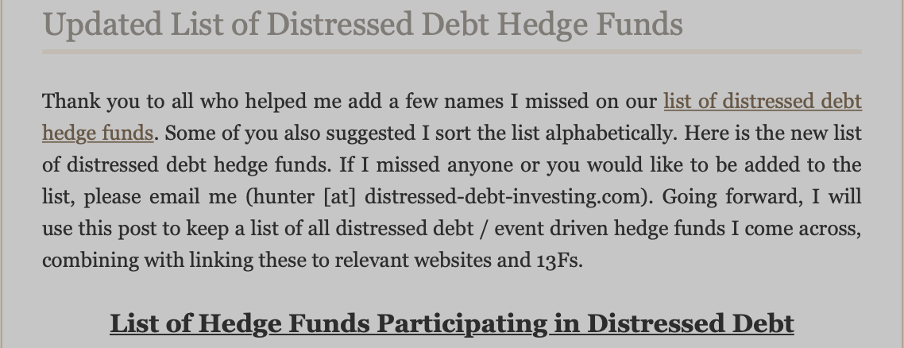
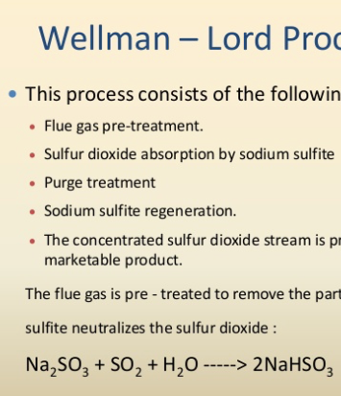

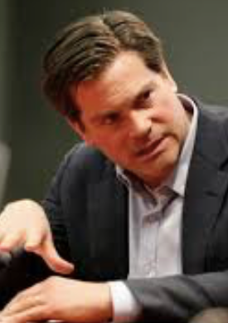
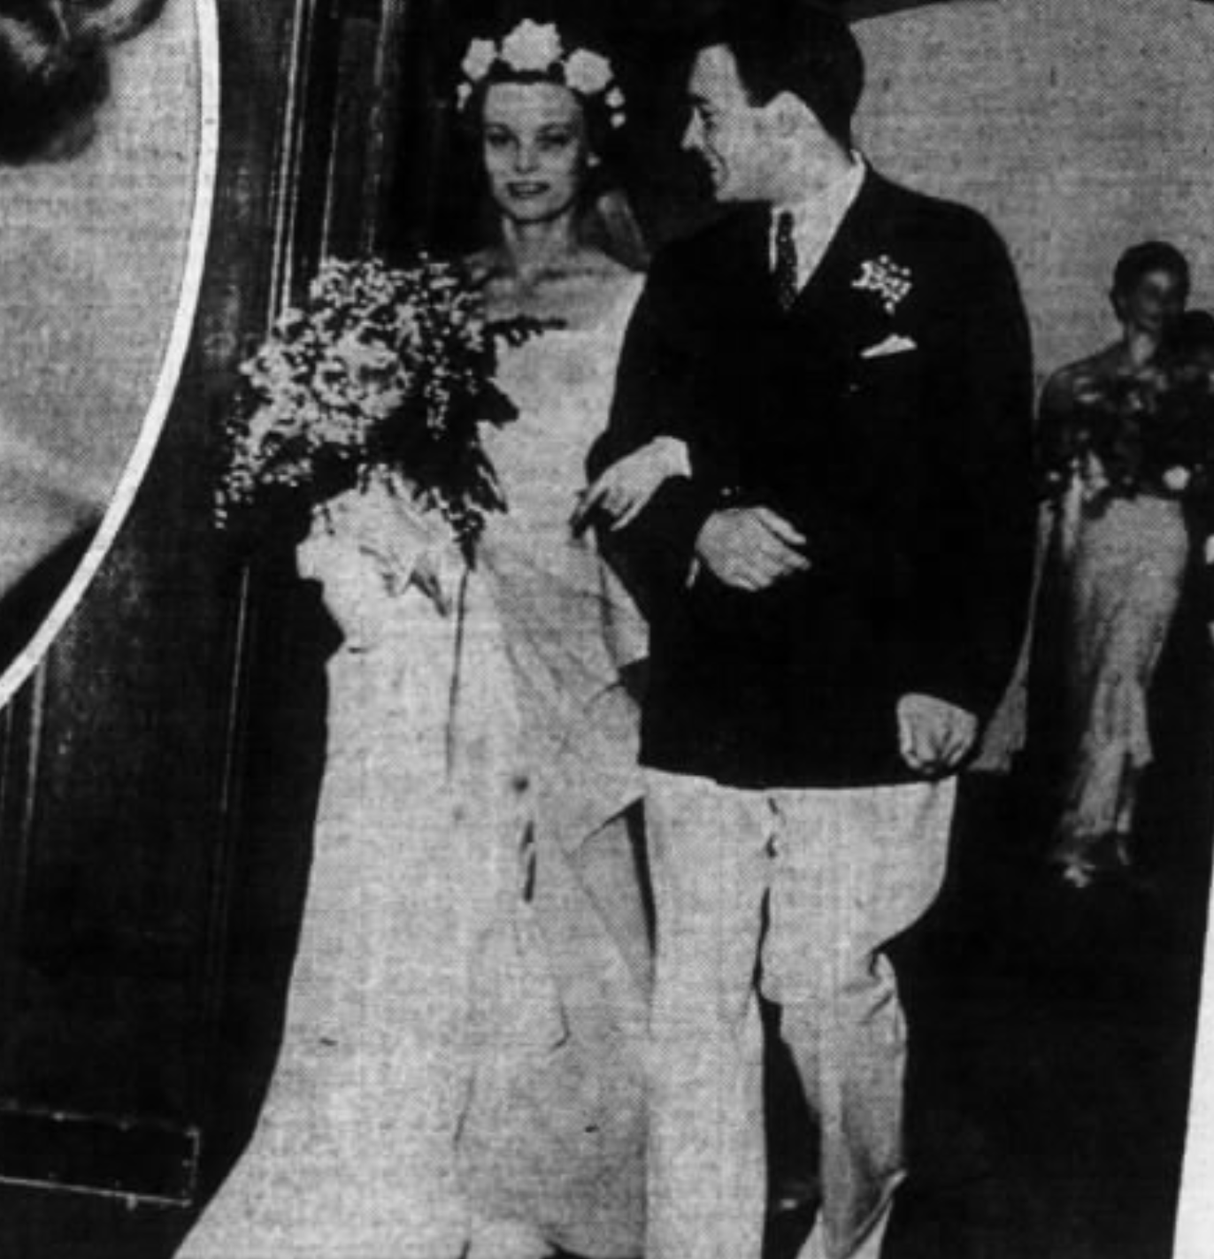
It is Not the “Technical” Training That Is the Most Valuable
In my extended family, three people who were, are, or look like they are headed for not the top 1% but the top 0.1%…
Industries:
construction and chemical engineering (ultimately pollution control)
“smart money” on Wall Street managing the flow of financing of investment,
“the industry” as they call it in LA…
Notes:
They will spend more time on the long 20th century then on any other earlier century. It will be salient, in that more and more that is important happened in the age than in any equal earlier length of time. Between the appearance of the iron-hulled oceangoing steamship, the submarine telegraph cable, and the industrial research lab around 1870 and the business cycle collapse followed by the anemic recovery of 2007-2015, the world was transformed more and more thoroughly than in any easier epoch of its or even many times its length. The two millennia of the discovery of agriculture and herding and the unknown period that marked the discovery and diffusion of fire might have matched it, and the invention of language surpassed it. But otherwise, of all eras that the human race has experienced to date, the long 20th century was the axis on which the wheel of history turned.
This is not to say that people 2000, 3000, 4000 years from now will spend a lot of time thinking about what they will call "ancient history", and we now simply call "history": A lot of water will flow under many bridges in what will be our future and their past. But what of their attention they do focus on us and our predecessors will give a large place to us and to our four generations of immediate ancestors.
The first thing that they will stress is that the history of the long 20th century is predominantly economic, or rather political-economic history.

Slide 11
It is Not the “Technical” Training That Is the Most Valuable
What was valuable?:
learning how to deal socially as a (relative) outsider at Harvard in the 1920s,
historical-critical source analysis in the 1980s,
messing around with Dartmouth AV in the 1990s
Notes:
They will spend more time on the long 20th century then on any other earlier century. It will be salient, in that more and more that is important happened in the age than in any equal earlier length of time. Between the appearance of the iron-hulled oceangoing steamship, the submarine telegraph cable, and the industrial research lab around 1870 and the business cycle collapse followed by the anemic recovery of 2007-2015, the world was transformed more and more thoroughly than in any easier epoch of its or even many times its length. The two millennia of the discovery of agriculture and herding and the unknown period that marked the discovery and diffusion of fire might have matched it, and the invention of language surpassed it. But otherwise, of all eras that the human race has experienced to date, the long 20th century was the axis on which the wheel of history turned.
This is not to say that people 2000, 3000, 4000 years from now will spend a lot of time thinking about what they will call "ancient history", and we now simply call "history": A lot of water will flow under many bridges in what will be our future and their past. But what of their attention they do focus on us and our predecessors will give a large place to us and to our four generations of immediate ancestors.
The first thing that they will stress is that the history of the long 20th century is predominantly economic, or rather political-economic history.

Slide 12
Learning Goals: Economic Literacy
The real learning goal for this course is: economic literacy.
At the end of the course, students should be able to take any article about the economy, whether in, say, the Financial Times or the Economist or the San Francisco Chronicle or Business Insider or vox.com:
Determine what assertions it is making about
how the economy works, and
what the current state of the economy is;
break down those assertions;
use economic logic and economic models and economic data to analyze them; and
conclude whether, and under what conditions, the arguments made make sense.
Notes:
They will spend more time on the long 20th century then on any other earlier century. It will be salient, in that more and more that is important happened in the age than in any equal earlier length of time. Between the appearance of the iron-hulled oceangoing steamship, the submarine telegraph cable, and the industrial research lab around 1870 and the business cycle collapse followed by the anemic recovery of 2007-2015, the world was transformed more and more thoroughly than in any easier epoch of its or even many times its length. The two millennia of the discovery of agriculture and herding and the unknown period that marked the discovery and diffusion of fire might have matched it, and the invention of language surpassed it. But otherwise, of all eras that the human race has experienced to date, the long 20th century was the axis on which the wheel of history turned.
This is not to say that people 2000, 3000, 4000 years from now will spend a lot of time thinking about what they will call "ancient history", and we now simply call "history": A lot of water will flow under many bridges in what will be our future and their past. But what of their attention they do focus on us and our predecessors will give a large place to us and to our four generations of immediate ancestors.
The first thing that they will stress is that the history of the long 20th century is predominantly economic, or rather political-economic history.

Slide 13
Applied to Understand Our Economic History
What will professors teach 2000 years from now?
All of our history will be “ancient history”
They will focus on the long 20th century
Between:
the appearance of the iron-hulled oceangoing steamship, the submarine telegraph cable, and the industrial research lab around 1870
the business cycle collapse followed by the anemic recovery of 2007-2015
More changed, and more things that were important changed than in any other century so far
Notes:
They will spend more time on the long 20th century then on any other earlier century. It will be salient, in that more and more that is important happened in the age than in any equal earlier length of time. Between the appearance of the iron-hulled oceangoing steamship, the submarine telegraph cable, and the industrial research lab around 1870 and the business cycle collapse followed by the anemic recovery of 2007-2015, the world was transformed more and more thoroughly than in any easier epoch of its or even many times its length. The two millennia of the discovery of agriculture and herding and the unknown period that marked the discovery and diffusion of fire might have matched it, and the invention of language surpassed it. But otherwise, of all eras that the human race has experienced to date, the long 20th century was the axis on which the wheel of history turned.
This is not to say that people 2000, 3000, 4000 years from now will spend a lot of time thinking about what they will call "ancient history", and we now simply call "history": A lot of water will flow under many bridges in what will be our future and their past. But what of their attention they do focus on us and our predecessors will give a large place to us and to our four generations of immediate ancestors.
The first thing that they will stress is that the history of the long 20th century is predominantly economic, or rather political-economic history.

Slide 14
Applied to Understand the Economy
What should we teach you here and now?
Center of gravity of your careers and influence will be 2050 or so
Want you to be:
Good citizens
Good partners in “commerce” and “congress”—broadly understood
How the economy works:
How it is built upon gift-exchange, trust, and sociology
How markets work
How markets fail
How bureaucracies fit in
Notes:
They will spend more time on the long 20th century then on any other earlier century. It will be salient, in that more and more that is important happened in the age than in any equal earlier length of time. Between the appearance of the iron-hulled oceangoing steamship, the submarine telegraph cable, and the industrial research lab around 1870 and the business cycle collapse followed by the anemic recovery of 2007-2015, the world was transformed more and more thoroughly than in any easier epoch of its or even many times its length. The two millennia of the discovery of agriculture and herding and the unknown period that marked the discovery and diffusion of fire might have matched it, and the invention of language surpassed it. But otherwise, of all eras that the human race has experienced to date, the long 20th century was the axis on which the wheel of history turned.
This is not to say that people 2000, 3000, 4000 years from now will spend a lot of time thinking about what they will call "ancient history", and we now simply call "history": A lot of water will flow under many bridges in what will be our future and their past. But what of their attention they do focus on us and our predecessors will give a large place to us and to our four generations of immediate ancestors.
The first thing that they will stress is that the history of the long 20th century is predominantly economic, or rather political-economic history.

Slide 15

The Nature of a University
Never thought this was necessary before…
It probably still isn’t necessary today…
But this past decade has been a very weird, very norm-breaking decade in a lot of ways
So it is best to be clear on what we are doing here…
This is a university…
Notes:
They will spend more time on the long 20th century then on any other earlier century. It will be salient, in that more and more that is important happened in the age than in any equal earlier length of time. Between the appearance of the iron-hulled oceangoing steamship, the submarine telegraph cable, and the industrial research lab around 1870 and the business cycle collapse followed by the anemic recovery of 2007-2015, the world was transformed more and more thoroughly than in any easier epoch of its or even many times its length. The two millennia of the discovery of agriculture and herding and the unknown period that marked the discovery and diffusion of fire might have matched it, and the invention of language surpassed it. But otherwise, of all eras that the human race has experienced to date, the long 20th century was the axis on which the wheel of history turned.
This is not to say that people 2000, 3000, 4000 years from now will spend a lot of time thinking about what they will call "ancient history", and we now simply call "history": A lot of water will flow under many bridges in what will be our future and their past. But what of their attention they do focus on us and our predecessors will give a large place to us and to our four generations of immediate ancestors.
The first thing that they will stress is that the history of the long 20th century is predominantly economic, or rather political-economic history.

Slide 16
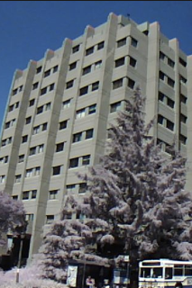
A University Is a Safe Space for Scholars
We all belong here
We all deserve to be treated with respect
We all deserve to be listened to
We all deserve to speak
We all deserve to be taught how to listen better
We all deserve to be taught how to speak better
We all deserve to be taught how to think better
Don’t set out to diss others
Don’t diss yourself
Notes:
They will spend more time on the long 20th century then on any other earlier century. It will be salient, in that more and more that is important happened in the age than in any equal earlier length of time. Between the appearance of the iron-hulled oceangoing steamship, the submarine telegraph cable, and the industrial research lab around 1870 and the business cycle collapse followed by the anemic recovery of 2007-2015, the world was transformed more and more thoroughly than in any easier epoch of its or even many times its length. The two millennia of the discovery of agriculture and herding and the unknown period that marked the discovery and diffusion of fire might have matched it, and the invention of language surpassed it. But otherwise, of all eras that the human race has experienced to date, the long 20th century was the axis on which the wheel of history turned.
This is not to say that people 2000, 3000, 4000 years from now will spend a lot of time thinking about what they will call "ancient history", and we now simply call "history": A lot of water will flow under many bridges in what will be our future and their past. But what of their attention they do focus on us and our predecessors will give a large place to us and to our four generations of immediate ancestors.
The first thing that they will stress is that the history of the long 20th century is predominantly economic, or rather political-economic history.

Slide 17

Responsibilities to Other Members of the University
Don’t be like Harvey Mansfield!
Harvey Mansfield:
“Everyone knows that C is an average grade…. Grade inflation got started… [when] white professors, imbibing the spirit of affirmative action, stopped giving low or average grades to black students and, to justify or conceal it, stopped giving those grades to white students as well…”
“You should keep your office door closed here. If you don’t, undergraduates might wander in…”
Notes:
They will spend more time on the long 20th century then on any other earlier century. It will be salient, in that more and more that is important happened in the age than in any equal earlier length of time. Between the appearance of the iron-hulled oceangoing steamship, the submarine telegraph cable, and the industrial research lab around 1870 and the business cycle collapse followed by the anemic recovery of 2007-2015, the world was transformed more and more thoroughly than in any easier epoch of its or even many times its length. The two millennia of the discovery of agriculture and herding and the unknown period that marked the discovery and diffusion of fire might have matched it, and the invention of language surpassed it. But otherwise, of all eras that the human race has experienced to date, the long 20th century was the axis on which the wheel of history turned.
This is not to say that people 2000, 3000, 4000 years from now will spend a lot of time thinking about what they will call "ancient history", and we now simply call "history": A lot of water will flow under many bridges in what will be our future and their past. But what of their attention they do focus on us and our predecessors will give a large place to us and to our four generations of immediate ancestors.
The first thing that they will stress is that the history of the long 20th century is predominantly economic, or rather political-economic history.

Slide 18
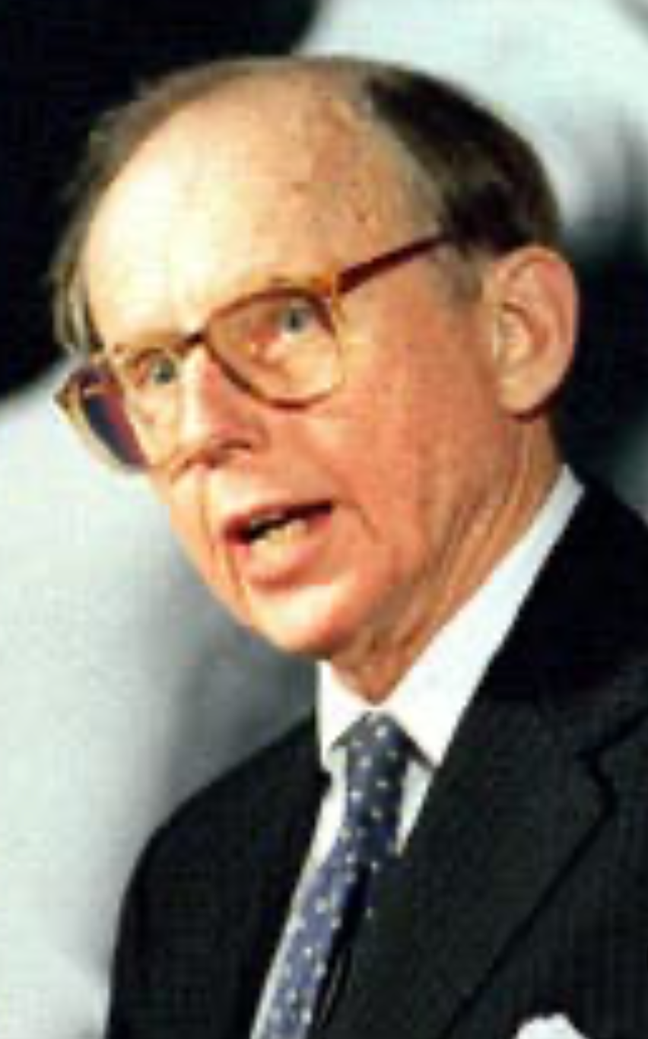
Responsibilities to Society at Large
Don’t be like Sam Huntington!
Sam Huntington:
“Unlike past immigrant groups, Mexicans and other Latinos have not assimilated… rejecting the Anglo-Protestant values that built the American dream.... The Hispanization of Miami is without precedent.... The Cuban takeover.... Anglos (as well as blacks)... [became] outside minorities… unable to communicate with… bureaucrats… discriminated against by store clerks… Anglos... could accept… subordinat[ion]... assimilate into the Hispanic community... or... leave... their exodus reflected in a popular bumper sticker: 'Will the last American to leave Miami, please bring the flag’...”
Notes:
They will spend more time on the long 20th century then on any other earlier century. It will be salient, in that more and more that is important happened in the age than in any equal earlier length of time. Between the appearance of the iron-hulled oceangoing steamship, the submarine telegraph cable, and the industrial research lab around 1870 and the business cycle collapse followed by the anemic recovery of 2007-2015, the world was transformed more and more thoroughly than in any easier epoch of its or even many times its length. The two millennia of the discovery of agriculture and herding and the unknown period that marked the discovery and diffusion of fire might have matched it, and the invention of language surpassed it. But otherwise, of all eras that the human race has experienced to date, the long 20th century was the axis on which the wheel of history turned.
This is not to say that people 2000, 3000, 4000 years from now will spend a lot of time thinking about what they will call "ancient history", and we now simply call "history": A lot of water will flow under many bridges in what will be our future and their past. But what of their attention they do focus on us and our predecessors will give a large place to us and to our four generations of immediate ancestors.
The first thing that they will stress is that the history of the long 20th century is predominantly economic, or rather political-economic history.

Slide 19
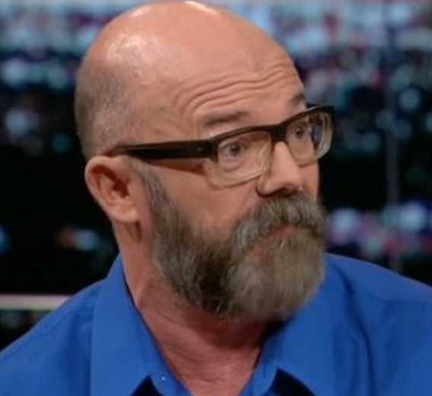

Be Sensitive to What You Are Saying!
Andrew Sullivan (2018): “Ta-Nehisi and I... there was a civility about it, an actual generosity of spirit, that transcended the boundaries of race and background.... Our engagement with each other and our readerships was a crackling and productive one… before Twitter swallowed blogging, before identity politics became completely nonnegotiable, before we degenerated into these tribal swarms of snark and loathing…”
Ta-Nehisi Coates (2018): “I got incredibly used to learning from people... quite good at their craft, who I felt, and pardon my language, were f***ing racist. And that was just the way the world was. I didn’t really have the luxury of having teachers who I necessarily felt, you know, saw me completely as a human being.... Me arguing with Andrew Sullivan about whether black people are genetically disposed to be dumber than white people. I actually had to take this seriously, you understand? I couldn’t speak… to Andrew on the blog the way I would speak to my wife about what Andrew said on the blog in the morning when it was just us…”
Notes:
They will spend more time on the long 20th century then on any other earlier century. It will be salient, in that more and more that is important happened in the age than in any equal earlier length of time. Between the appearance of the iron-hulled oceangoing steamship, the submarine telegraph cable, and the industrial research lab around 1870 and the business cycle collapse followed by the anemic recovery of 2007-2015, the world was transformed more and more thoroughly than in any easier epoch of its or even many times its length. The two millennia of the discovery of agriculture and herding and the unknown period that marked the discovery and diffusion of fire might have matched it, and the invention of language surpassed it. But otherwise, of all eras that the human race has experienced to date, the long 20th century was the axis on which the wheel of history turned.
This is not to say that people 2000, 3000, 4000 years from now will spend a lot of time thinking about what they will call "ancient history", and we now simply call "history": A lot of water will flow under many bridges in what will be our future and their past. But what of their attention they do focus on us and our predecessors will give a large place to us and to our four generations of immediate ancestors.
The first thing that they will stress is that the history of the long 20th century is predominantly economic, or rather political-economic history.

Slide 20


Be Sensitive to What You Are Saying! II
Henry Farrell (2018): “Sullivan’s and Coates’s pieces provide a miniature history of how a certain variety of self-congratulatory openness to inquiry is in actual fact a barbed thicket of power relations. What Sullivan depicts as… ’civility' and 'generosity of spirit’… [is] Coates’s 'teachers' who didn’t see him 'completely as a human being'. What was open and free spirited debate in Sullivan’s depiction, was to Coates a loaded and poisonous dialogue where he could only participate if he shut up about what he actually believed…”
Andrew Sullivan (2001): “The Krugmans and the Chaits will shortly have a cow, if not a whole herd of them.… Some commentators… get steamed because Bush has… claimed his tax cut will cost less than it actually will, or because he is using Medicare surplus money today that will be needed tomorrow and beyond…. The deeper point… [is] that Bush has to obfuscate his real goals of reducing spending with the smoke screen of ‘compassionate conservatism’ … [in his] uphill… struggle is…”
Matthew Yglesias (2005): “Andrew Sullivan… consistent proponent… that Paul Krugman is some sort of liar… [because of his] repeated insistences that George W. Bush's economic policy is founded on a tissue of lies…. The unnoted irony here is that … [on] May 14, 2001… Sullivan conceded Krugman's point…”
Notes:
They will spend more time on the long 20th century then on any other earlier century. It will be salient, in that more and more that is important happened in the age than in any equal earlier length of time. Between the appearance of the iron-hulled oceangoing steamship, the submarine telegraph cable, and the industrial research lab around 1870 and the business cycle collapse followed by the anemic recovery of 2007-2015, the world was transformed more and more thoroughly than in any easier epoch of its or even many times its length. The two millennia of the discovery of agriculture and herding and the unknown period that marked the discovery and diffusion of fire might have matched it, and the invention of language surpassed it. But otherwise, of all eras that the human race has experienced to date, the long 20th century was the axis on which the wheel of history turned.
This is not to say that people 2000, 3000, 4000 years from now will spend a lot of time thinking about what they will call "ancient history", and we now simply call "history": A lot of water will flow under many bridges in what will be our future and their past. But what of their attention they do focus on us and our predecessors will give a large place to us and to our four generations of immediate ancestors.
The first thing that they will stress is that the history of the long 20th century is predominantly economic, or rather political-economic history.

Slide 21

A University Is a Safe Space for Ideas
The purpose of a university is to generate, examine, and assess ideas
It is antithetical for outsiders or insiders to limit ideas generated
It is also antithetical not to examine and assess ideas seriously and honestly
This is a very delicate balancing act
what ideas—left to “your conscience and your god” (Kantorowicz)
how to treat them—norms of scholarship
Cf: <http://delong.typepad.com/delong_long_form/2016/05/the-economist-as-the-public-square-and-economists.html>
Notes:
They will spend more time on the long 20th century then on any other earlier century. It will be salient, in that more and more that is important happened in the age than in any equal earlier length of time. Between the appearance of the iron-hulled oceangoing steamship, the submarine telegraph cable, and the industrial research lab around 1870 and the business cycle collapse followed by the anemic recovery of 2007-2015, the world was transformed more and more thoroughly than in any easier epoch of its or even many times its length. The two millennia of the discovery of agriculture and herding and the unknown period that marked the discovery and diffusion of fire might have matched it, and the invention of language surpassed it. But otherwise, of all eras that the human race has experienced to date, the long 20th century was the axis on which the wheel of history turned.
This is not to say that people 2000, 3000, 4000 years from now will spend a lot of time thinking about what they will call "ancient history", and we now simply call "history": A lot of water will flow under many bridges in what will be our future and their past. But what of their attention they do focus on us and our predecessors will give a large place to us and to our four generations of immediate ancestors.
The first thing that they will stress is that the history of the long 20th century is predominantly economic, or rather political-economic history.

Slide 22
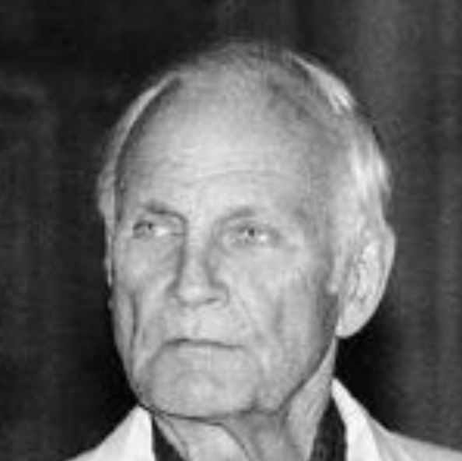
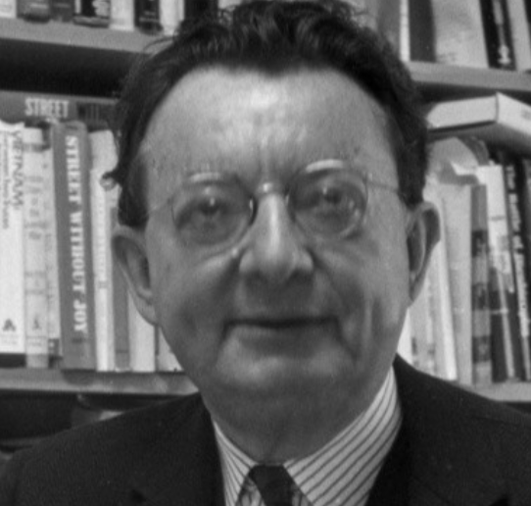
Responsibilities to Ideas
Don’t be like Paul Sweezy!
Q: “[Your] editorial after Stalin died in 1953, for instance, called him one of the greatest men in history, I believe…
Paul Sweezy: “Something like that. Well, in some ways he was, but he had his underside, too. I guess one should have been more cautious, but I think you had to take positions which were pretty much unambiguous. Either you were for or against the regimes, the actually existing socialist countries…. Early on there was a position… that the Soviet Union was an ideal new society. Gradually one had to get over that. But not by turning around, becoming an enemy, joining the other side. That's always a difficult line to follow, I think, but it's absolutely essential…”
Contrast with I.F. Stone: “After seeing the Soviet Union and studying the statements of its leading officials: This is not a good society and it is not led by honest men. No society is good in which men fear to think--much less speak--freely. I don't care how many tons of steel the Russians produce…”
Notes:
They will spend more time on the long 20th century then on any other earlier century. It will be salient, in that more and more that is important happened in the age than in any equal earlier length of time. Between the appearance of the iron-hulled oceangoing steamship, the submarine telegraph cable, and the industrial research lab around 1870 and the business cycle collapse followed by the anemic recovery of 2007-2015, the world was transformed more and more thoroughly than in any easier epoch of its or even many times its length. The two millennia of the discovery of agriculture and herding and the unknown period that marked the discovery and diffusion of fire might have matched it, and the invention of language surpassed it. But otherwise, of all eras that the human race has experienced to date, the long 20th century was the axis on which the wheel of history turned.
This is not to say that people 2000, 3000, 4000 years from now will spend a lot of time thinking about what they will call "ancient history", and we now simply call "history": A lot of water will flow under many bridges in what will be our future and their past. But what of their attention they do focus on us and our predecessors will give a large place to us and to our four generations of immediate ancestors.
The first thing that they will stress is that the history of the long 20th century is predominantly economic, or rather political-economic history.

Slide 23
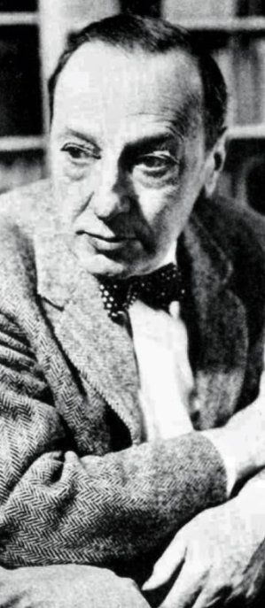
The University of California Loyalty Oath
Do be like Ernst Kantorowicz:
“Three professions… wear a gown: the judge, the priest, the scholar. This garment stands for its bearer's maturity of mind, his independence of judgment, and his direct responsibility to his conscience and to his God….
“It is a shameful and undignified action,
it is an affront and a violation of both human sovereignty and professional dignity
that the Regents of this University have dared to bully the bearer of this gown into a situation in which—under the pressure of a bewildering economic coercion—
he is compelled to give up either his tenure or, together with his freedom of judgment, his human dignity and his responsible sovereignty as a scholar…
<http://www.lib.berkeley.edu/uchistory/archives_exhibits/loyaltyoath/symposium/kantorowicz.html>
Notes:
They will spend more time on the long 20th century then on any other earlier century. It will be salient, in that more and more that is important happened in the age than in any equal earlier length of time. Between the appearance of the iron-hulled oceangoing steamship, the submarine telegraph cable, and the industrial research lab around 1870 and the business cycle collapse followed by the anemic recovery of 2007-2015, the world was transformed more and more thoroughly than in any easier epoch of its or even many times its length. The two millennia of the discovery of agriculture and herding and the unknown period that marked the discovery and diffusion of fire might have matched it, and the invention of language surpassed it. But otherwise, of all eras that the human race has experienced to date, the long 20th century was the axis on which the wheel of history turned.
This is not to say that people 2000, 3000, 4000 years from now will spend a lot of time thinking about what they will call "ancient history", and we now simply call "history": A lot of water will flow under many bridges in what will be our future and their past. But what of their attention they do focus on us and our predecessors will give a large place to us and to our four generations of immediate ancestors.
The first thing that they will stress is that the history of the long 20th century is predominantly economic, or rather political-economic history.

Slide 24
Catch Our Breath…
What’s up next?
Comments?
Questions?

Slide 25
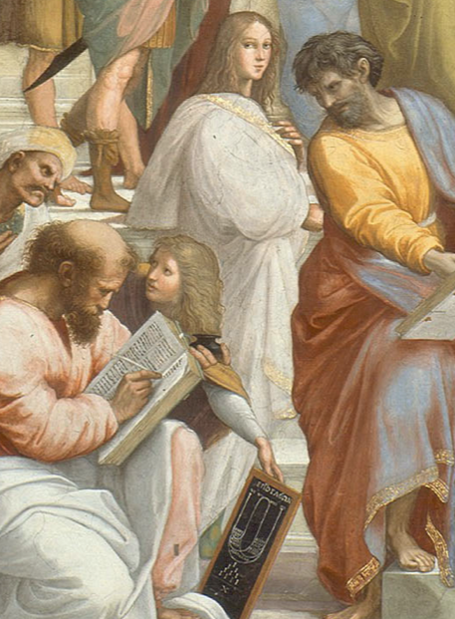
So Learn!: Extend Your Brains in Every Direction Your Curiosity Moves You
References in this lecture you may not be familiar with:
“Avicenna”: Peter Beagle (1987): The Folk of the Air <http://amzn.to/1PvCcdN>.
Ibn Sina: Abū ʿAlī al-Ḥusayn ibn ʿAbd Allāh ibn Al-Hasan ibn Ali ibn Sīnā <http://tinyurl.com/n58rjc6>
“State of Euphoria”: David Lodge (1975): Changing Places <http://amzn.to/1nhoXXp>.
Enkidu: Gilgamesh <http://amzn.to/1PepdkP>.
Fujiwara Takako: Genji Monogatari <http://amzn.to/1nhCkXy>.
Hypatia <http://tinyurl.com/z9uyqy>:
Ibn Khaldun: Abū Zayd ‘Abd ar-Raḥmān ibn Muḥammad ibn Khaldūn al-Ḥaḍramī, Muquaddimah <http://amzn.to/1Sd0uhv>.
Odysseus: <http://amzn.to/1nhCA94>.
Notes:
They will spend more time on the long 20th century then on any other earlier century. It will be salient, in that more and more that is important happened in the age than in any equal earlier length of time. Between the appearance of the iron-hulled oceangoing steamship, the submarine telegraph cable, and the industrial research lab around 1870 and the business cycle collapse followed by the anemic recovery of 2007-2015, the world was transformed more and more thoroughly than in any easier epoch of its or even many times its length. The two millennia of the discovery of agriculture and herding and the unknown period that marked the discovery and diffusion of fire might have matched it, and the invention of language surpassed it. But otherwise, of all eras that the human race has experienced to date, the long 20th century was the axis on which the wheel of history turned.
This is not to say that people 2000, 3000, 4000 years from now will spend a lot of time thinking about what they will call "ancient history", and we now simply call "history": A lot of water will flow under many bridges in what will be our future and their past. But what of their attention they do focus on us and our predecessors will give a large place to us and to our four generations of immediate ancestors.
The first thing that they will stress is that the history of the long 20th century is predominantly economic, or rather political-economic history.

Slide 26
Catch Our Breath…
What’s up next?
Comments?
Questions?

